Slide 1
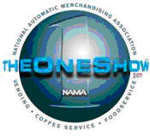
Developing a Focused Growth Strategy
A Blueprint for Driving Profitable Growth
(Excerpts)
2012 NAMA OneShow
National Automatic Merchandising Association
Venetian/Sands Resort
Las Vegas, Nevada
Wednesday, April 25, 2012
11:00-12:30
Dr. Mark L. Frigo, PhD, CPA, CMA
Ledger & Quill Alumni Foundation Distinguished Professor
Director, The Center for Strategy, Execution, and Valuation
and the Strategic Risk Management Lab
Kellstadt Graduate School of Business
DePaul University Chicago, IL (USA)
mfrigo@depaul.edu www.markfrigo.com
© Copyright Mark L. Frigo 2011 - Do not copy or redistribute without express written consent of Dr. Mark L. Frigo

Slide 2
From Going Nowhere…..

Slide 3
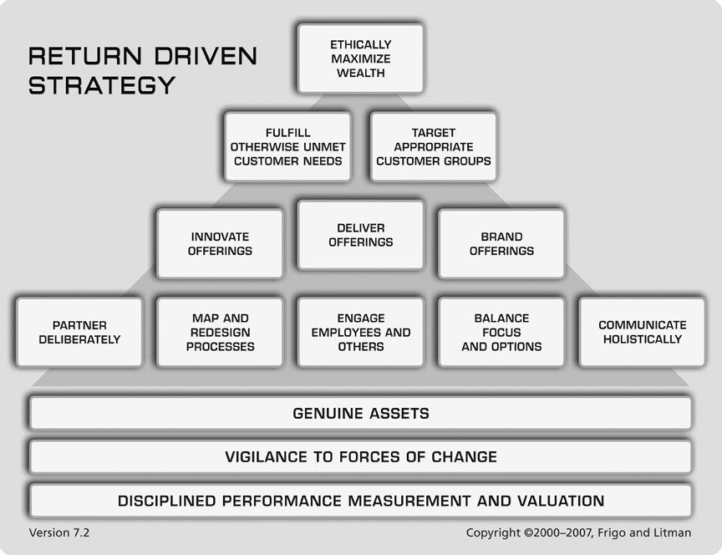
From Going Nowhere…..To Growing the Business
Enter Return Driven Strategy

Slide 4
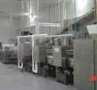
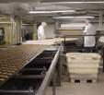
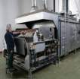
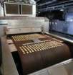
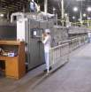
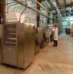
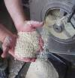
Case Study: Developing a Focused Growth Strategy
TL Green Biscuit & Cracker Indianapolis, Indiana
ExACT Continuous Mixing Robesonia, Pennsylvania
Reading Pretzel & Snack Robesonia, Pennsylvania
E.I. Groff Technical Center Sinking Spring, Pennsylvania
Reading Thermal Systems Robesonia, Pennsylvania

Slide 5
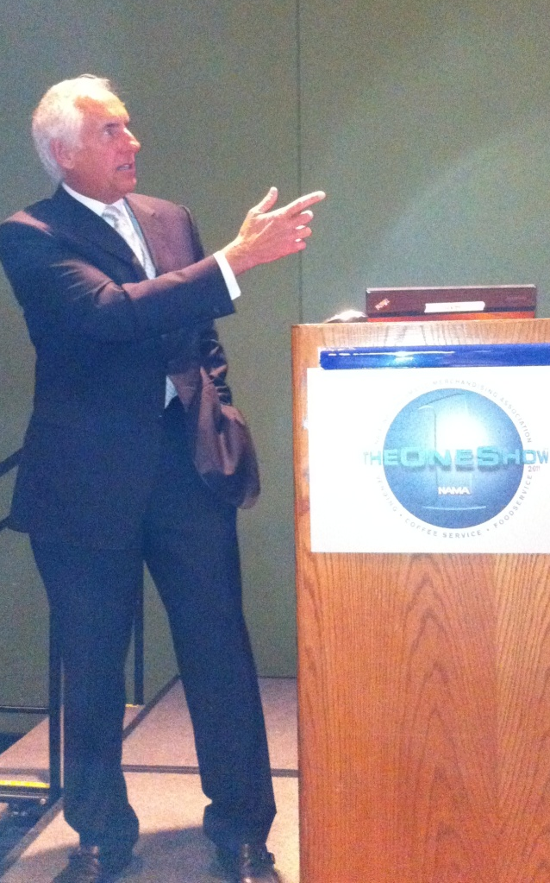
NAMA OneShow McCormick Place April 27, 2011 Dr. Mark L. Frigo and Terry Groff present the RBS Success Story

Slide 6
Terry Groff, Chairman – Reading Bakery Systems An Introduction to Reading Bakery Systems

Slide 7
Terry Groff, Chairman – Reading Bakery Systems How the Return Driven Strategy framework helped us

Slide 8
Terry Groff, Chairman – Reading Bakery Systems Return Driven Strategy “Changing the Way You Think”

Slide 9
Terry Groff, Chairman – Reading Bakery Systems “Changing the Way We Think”………..“The Results”

Slide 10
Revenue +190%

Slide 11
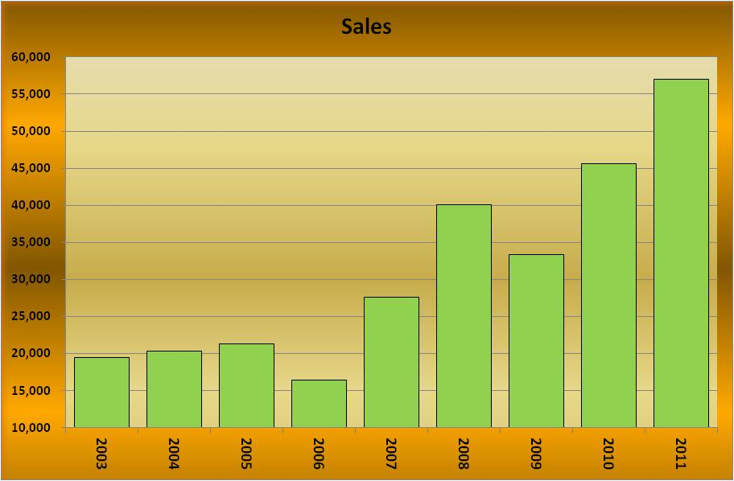
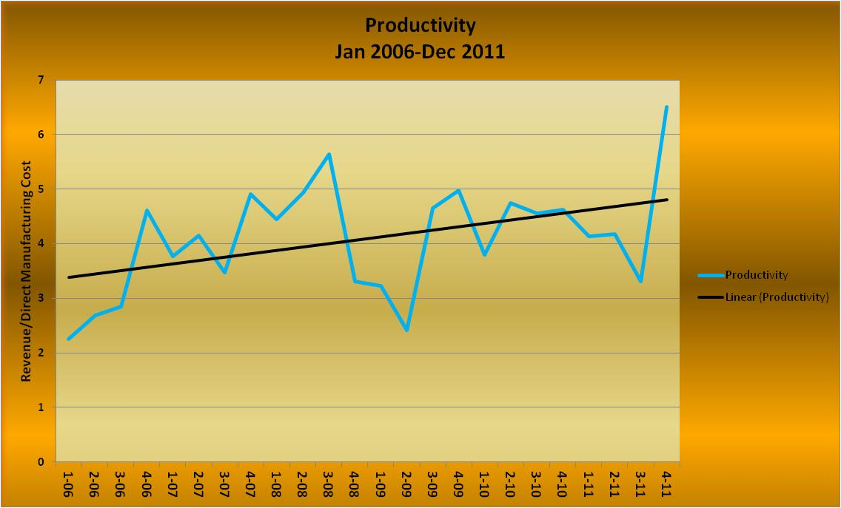
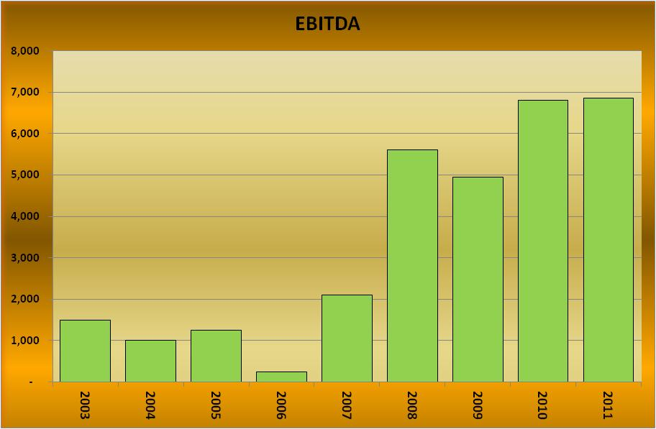
The Results

Slide 12
Developing a Focused Growth Strategy A Blueprint for Driving Profitable Growth Wednesday, April 25, 2012 - 11:00 a.m. - 12:30 p.m.
1. Target the Right Customer Needs
Focus your business on the changing unmet needs of your customers and emerging new customers
2. Target the Right Customers
Target the right customer groups, groups of customers with increasing needs you can fulfill with your unique capabilities and value your offerings
3. Change and Innovate Your Offerings
Continuously change (innovate) your offerings to better fulfill changing customer needs
4. Brand Your Offerings
Actively “brand” your offering by making the connection in the mind of your customers between your offerings and their unmet needs
5. Use the Right Incentives and Measures
Use the right incentives and performance measures to drive the business toward greater value of the business

Slide 13
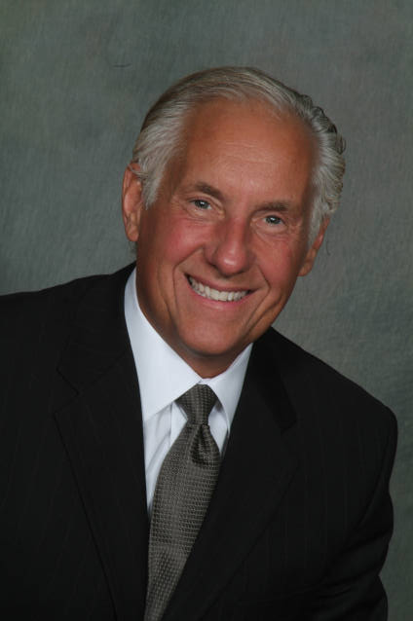
About the Speaker
Dr. Mark L. Frigo is Director of the Center for Strategy, Execution and Valuation and the Strategic Risk Management Lab in the Kellstadt Graduate School of Business at DePaul University in Chicago. He is Ledger & Quill Alumni Foundation Distinguished Professor of Strategy and Leadership in the Richard H. Driehaus College of Business at DePaul University.
Author of six books and over 100 articles, his work is published in leading business journals including Harvard Business Review. Dr. Frigo is a Certified Public Accountant (CPA), a Certified Management Accountant (CMA) and holds a Ph.D. in Econometrics. He is co-author of DRIVEN: Business Strategy, Human Actions and the Creation of Wealth which is used by management teams to drive superior performance and Strategic Risk Management: A Primer for Directors and Management Teams (2011) and author of the forthcoming book DRIVEN STRATEGY: Create and Sustain Superior Performance (2012). Dr. Frigo presents keynotes and executive workshops throughout North America, Europe and Asia-Pacific.
Dr. Frigo is an advisor to executive teams and boards in Fortune 500 companies, Inc 500 companies and entrepreneurs in developing innovation and growth strategies.
For articles, videos and presentation materials please see www.markfrigo.com

